Slide 1
Project 1: Speech Data Classification
Avery Peiffer

Slide 2
Problem statement
Given speech data for Parkinson’s Disease (PD) patients and healthy subjects
Implement ML algorithms to attempt to learn the pattern for classification
Logistic Regression
Quadratic Discriminant Analysis
Support Vector Machine

Slide 3
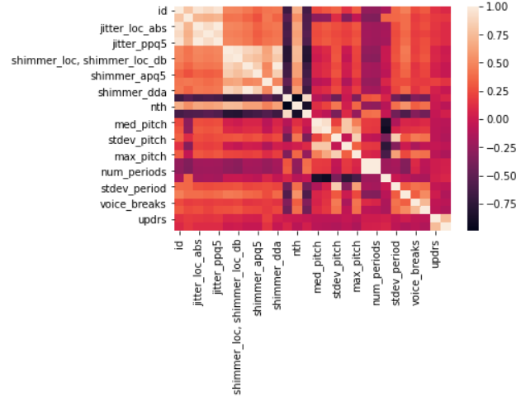
Data visualization
Generated a correlation heatmap with Seaborn package
(Class label is at the bottom-most row and right-most column)
Difficult to tell what variables are highly correlated with class label

Slide 4
Other Data notes
Used MinMaxScaler() to transform data before training algorithms
The data needs to be scaled in this way because the features have widely different scales, which would negatively affect any algorithm the data is used to train
Ex: max_pitch is >100, while mean_period is < 0.01

Slide 5
Algorithm notes
Logistic regression had poor initial accuracy of 0.07
Attempted to do 5-fold cross validation to find the best regularization parameter for the model
Regularization attempts to avoid overfitting by adding an additional penalty term in the error function
After cross validation, trainval accuracy was 0.54, but test accuracy was only 0.11

Slide 6
Algorithm Notes (cont.)
Used QDA instead of LDA because classes likely have different covariance matrices
Achieved a test accuracy of 0.83
Similarly, SVM achieved accuracy of 0.8274 using Radial Basis Function kernel

Slide 7
Overall results
Model | Accuracy
Random Guessing | 0.5
Logistic Regression (no CV) | 0.07
Logistic Regression (with CV) | 0.11
QDA | 0.83
SVM | 0.8274

